Slide 1

Task No. :05
EMOTION DETECTION
FROM TEXT :

Slide 2
Data Collection -
The dataset is collected from an open source .
The dataset includes a total of 34792 texts which is categorized into eight emotional classes(anger, disgust, fear, joy, neutral, sadness, shame, surprise) .
Data Preprocessing -
If data was missing from the dataset, it was dropped using dropna.
User handles, stopwords, and punctuations were removed from the dataset using neattext.
Text was converted into numerical values using TF-IDF, which assigns importance to words that are frequent in a particular document but not common across all documents.
After this, SMOTE was applied to oversample the minority emotion classes. It was used to handle class imbalance.

Slide 3
Data Splitting -
The new balanced dataset was split into training and test datasets where 20% of the data will be used for testing & 80% for training.
Model Training -
Logistic regression is used here for model training. It is a supervised machine learning algorithm that is used for classification tasks, where the goal is to predict the probability that an instance belongs to a given class or not.
A LogisticRegression model object is created in the line:
model = LogisticRegression(max_iter=3000, solver='liblinear')
After this, the model is fitted (trained) using X_train and y_train.
Once training is completed, the trained model is saved and a function is defined with preprocessing steps to predict the emotion of sample examples.
Afterward, the previously saved model and vectorizer are loaded to allow their reuse without retraining, especially in deployment.

Slide 4
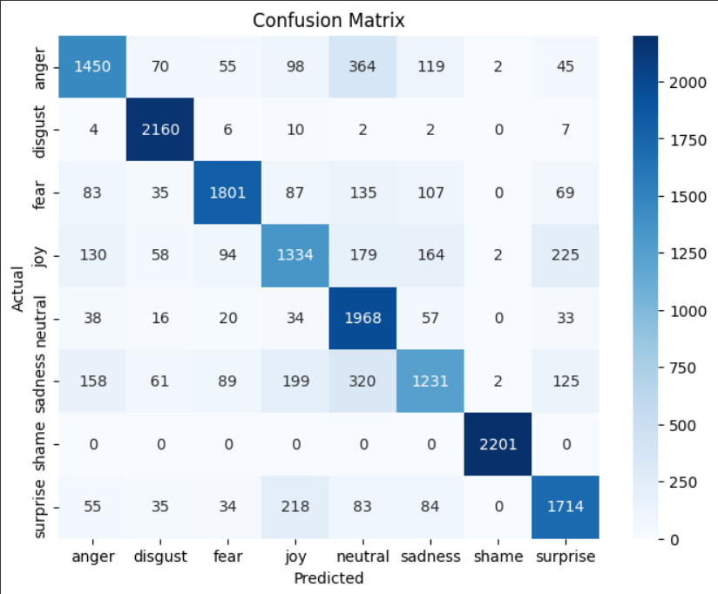
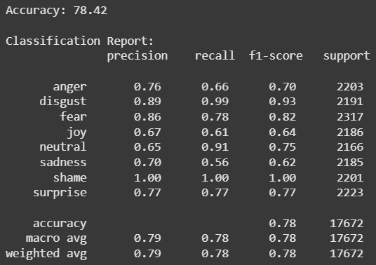
Result Analysis -
The evaluation metrics used here are accuracy, classification report, and confusion matrix.
The model’s accuracy was recorded as 78.42%.
Disgust, neutral, shame, and fear are found to have the highest recall among the classes for every model. This indicates that these emotions are correctly predicted most of the time.
Anger, sadness, joy and surprise are observed to have the lowest recall among the classes. This suggests that these emotions may have features that are difficult to be identified by the model.

Slide 5
Future Scope And Limitations -
Limitations :
Insufficient training data for anger, joy, surprise and sadness.
Dataset is imbalanced.
Findings :
Collecting more data, especially for the less accurately predicted emotions.
Trying different feature extraction techniques.
Future Scope :
Use BERT or transformer-based models for deeper understanding

Slide 6
THANK YOU

